Slide 1


Android Lecture #11
Thread Animation,
Tweened Animation

Slide 2


Index
Thread Animation
Example
Tweened Animation
Example

Slide 3

1. Thread Animation
Thread Animation
Change several image sequentially by using thread
SurfaceView
Kind of view that can express TextView and ImageView
Handle several image quickly
Use Thread in main

Slide 4
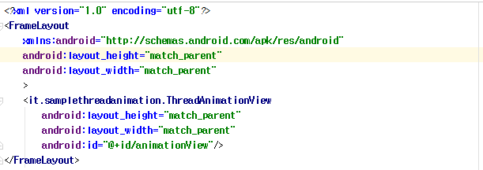
2. Example
Layout (activity_main.xml)
Add new defined view
File directory

Slide 5
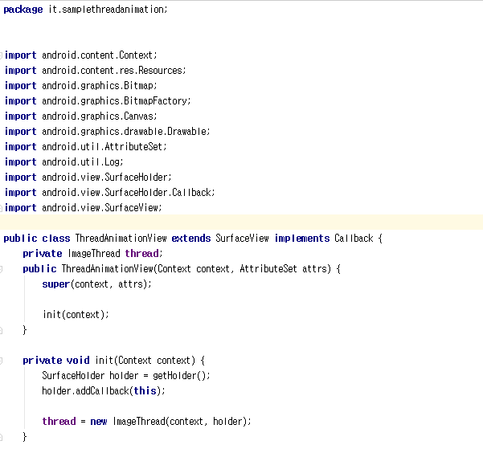
2. Example
Java source(ThreadAnimationView.java)
Surface view status 3 method
Inflation process -> Receive parameter and attribute

Slide 6
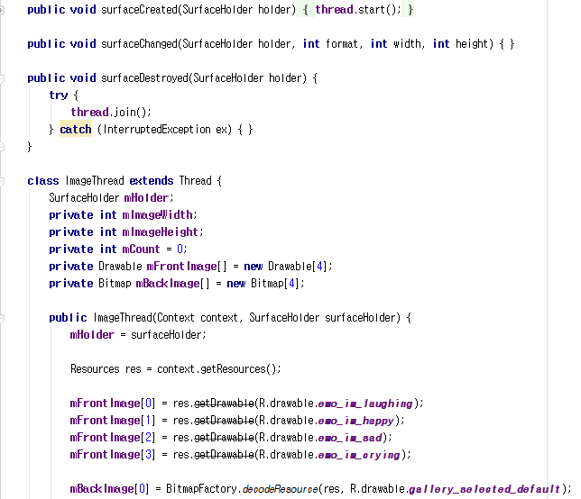
2. Example
Java source(ThreadAnimationView.java)
Define thread that making animation using several images

Slide 7
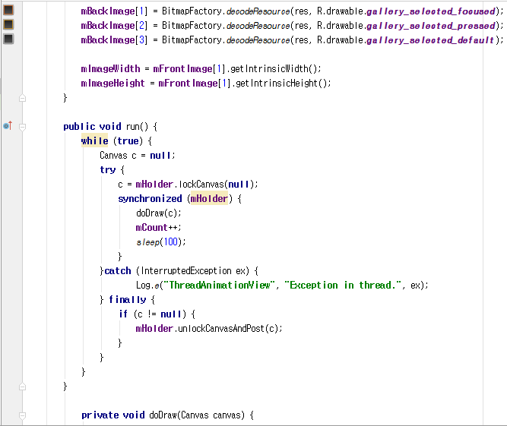
2. Example
Java source(ThreadAnimationView.java)
Set height and width

Slide 8
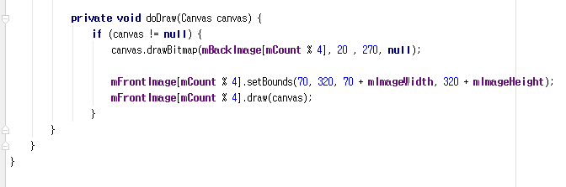
2. Example
Java source(ThreadAnimationView.java)

Slide 9
3. Tweened Animation
Tweened Animation
Calculate animation path and show image
Tweened Animation Composition
Section | Name | Explanation
Object | View | Widget and layout
 | Paint object | Graphic and image file(Bitmap image)
Effect | Move position | Translate : move position
 | Zooming | Scale : Effect that can change size
 | Rotation | Rotate : Rotate object
 | Transparency | Alpha : Regulate transparency

Slide 10
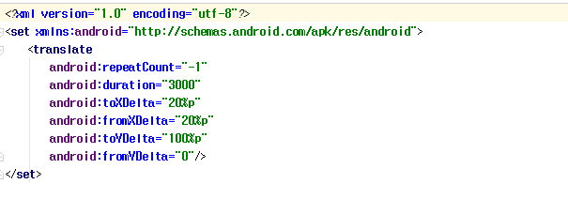
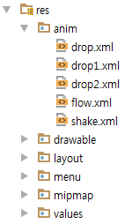
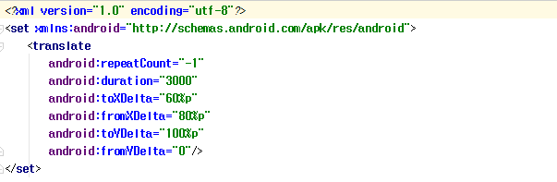
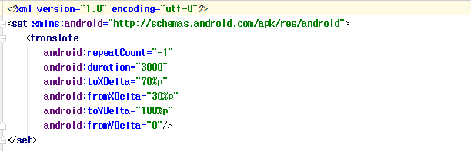
4. Example
drawable/amin/drop
Animation effect
Drop1
Drop2
Drop3

Slide 11
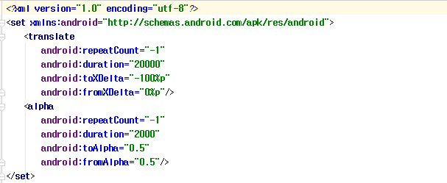
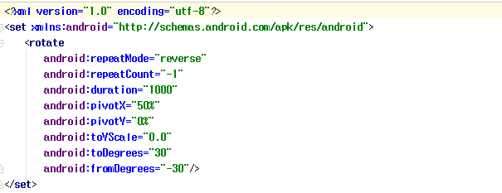
4. Example
drawable/amin/flow
drawable/amin/shake

Slide 12
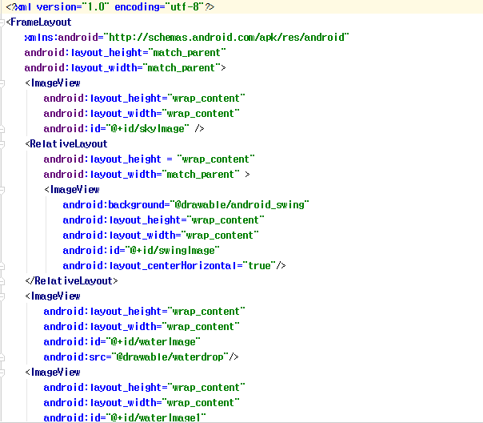
4. Example
Layout(activity_main.xml)

Slide 13
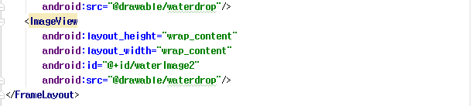
4. Example
Layout(activity_main.xml)

Slide 14
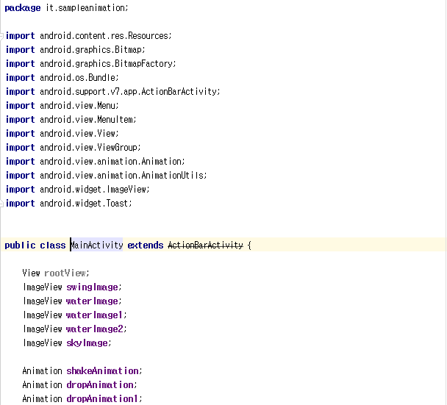
4. Example
JavaSource (MainActivity.java)
Make each image and animation

Slide 15
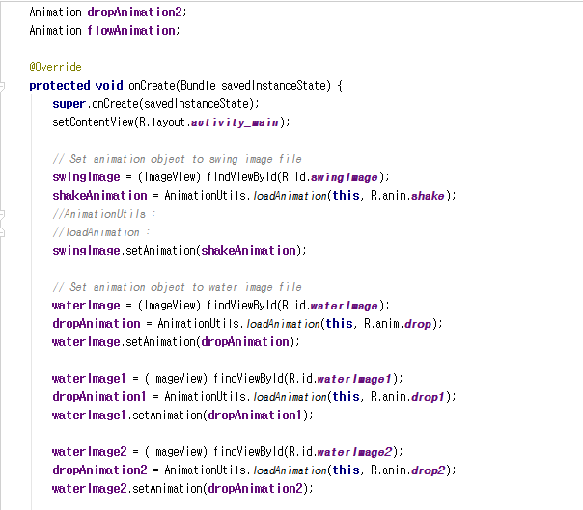
4. Example
JavaSource (MainActivity.java)
Animation action reference
and animation information loading

Slide 16
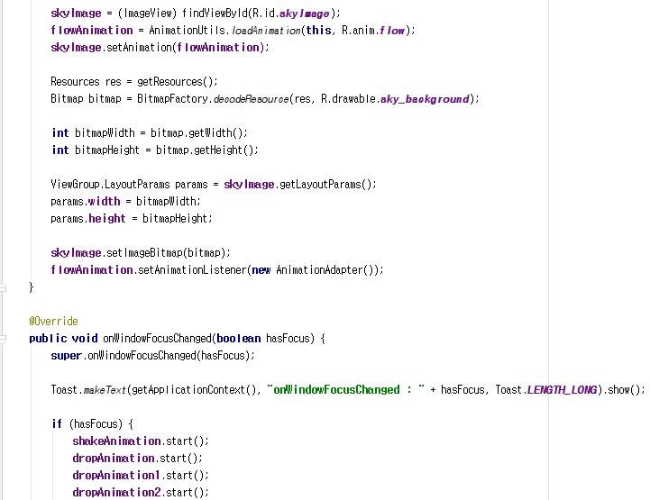
4. Example
JavaSource (MainActivity.java)
Transform size
Start animation
has focus : status of focusing window
true : focus window
false : not focus window

Slide 17
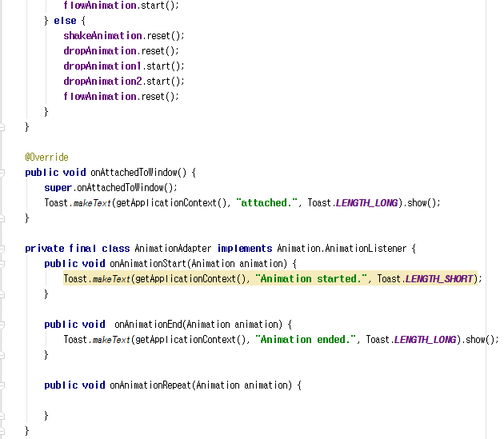
4. Example
JavaSource (MainActivity.java)
Set animation start, end, and status

Slide 18
Thank you!

